Slide 1
Other Features of SQL Server
Other DBMS may vary…

Slide 2
SQL Agent
With database management, there will always be jobs you want to run on a schedule.
Windows, coming from a desktop perspective, has never had a great answer to cron.
SQL Server includes SQL Agent – a UI driven (although you can use SQL!) tool for scheduling jobs.
In an infrastructure that is heavily Windows, SQL Agent can become your primary scheduler. We once used it to invoke our C# job scheduler…

Slide 3
SQL Agent Has Jobs
A job consists of steps. Each step is an executable action – something that can be done. Some of the steps that SQL Agent can run:
Run an executable (with command line parameters)
Run SQL Commands
Run SSIS

Slide 4
SQL Agent has impersonation, logging, alerts
SQL Agent can securely store credentials and can run a job step as any other user. This allows, for example, DBAs to create agents that run as themselves or as a system account.
Every job step is logged – start time, end time and error information if any.
SQLAgent has configurable alerts – it can email or net send.

Slide 5
SQL Agent has schedules
A schedule can run only on chosen days, at chosen times, once ever, when the CPU is idle, on demand, much more.
SQL Agent is a great tool for adding timed events to your infrastructure. Don’t build what you can get for FREE!

Slide 6
SQL Server can email (DBMail)
There are many “ancillary” services that SQL Server offers that benefit from having email available to them. It made a lot of sense to the SQL Server team to create a common gateway for email so that all of these ancillary services (like SQL Agent) could get send email.
Once email is configured on the server, through the UI, you can invoke a stored procedure to send an email message. The database logs the email and a process sends it out.

Slide 7
In the system database ‘MSDB’:
CREATE PROCEDURE [dbo].[sp_send_dbmail]
@profile_name sysname = NULL,
@recipients VARCHAR(MAX) = NULL,
@copy_recipients VARCHAR(MAX) = NULL,
@blind_copy_recipients VARCHAR(MAX) = NULL,
@subject NVARCHAR(255) = NULL,
@body NVARCHAR(MAX) = NULL,
@body_format VARCHAR(20) = NULL,
@importance VARCHAR(6) = 'NORMAL',
@sensitivity VARCHAR(12) = 'NORMAL',
@file_attachments NVARCHAR(MAX) = NULL,
@query NVARCHAR(MAX) = NULL,
@execute_query_database sysname = NULL,
@attach_query_result_as_file BIT = 0,
@query_attachment_filename NVARCHAR(260) = NULL,
@query_result_header BIT = 1,
@query_result_width INT = 256,
@query_result_separator CHAR(1) = ' ',
@exclude_query_output BIT = 0,
@append_query_error BIT = 0,
@query_no_truncate BIT = 0,
@query_result_no_padding BIT = 0,
@mailitem_id INT = NULL OUTPUT,
@from_address VARCHAR(max) = NULL,
@reply_to VARCHAR(max) = NULL

Slide 8
Reliability
There are several features in SQL Server that are intended to increase reliability.
What can cause a DBMS to be come unavailable?

Slide 9
Reliability
There are several features in SQL Server that are intended to increase reliability.
What can cause a DBMS to be come unavailable?
Hardware failure (CPU, memory, power supply, fan)
Operating System failure
Disk failure
Networking failure (cable, switch)
SQL Server Bug (NO!!!!!!!!)

Slide 10
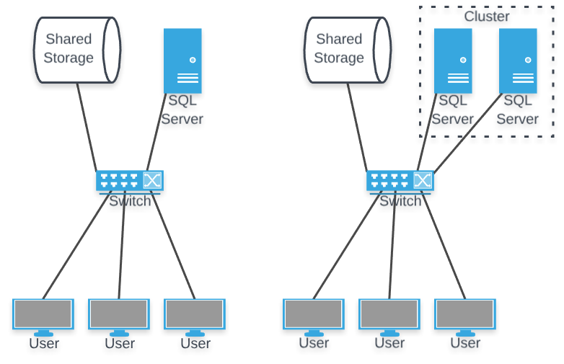
Clusters
If you have storage that is not on the SQL server itself, but is shared on the network, consider a cluster.
When one server goes down, the other takes over.

Slide 11
How does clustering do?
Hardware failure (CPU, memory, power supply, fan)
Operating System failure
Disk failure
Networking failure (cable, switch)
SQL Server Bug (NO!!!!!!!!)
Clustering DOES NOT improve performance. It reduces, but does not eliminate downtime. It doesn’t save or make backups unnecessary.
It CAN be helpful when one of the failures above happen OR when you want to do a live update of your SQL Server (say, an operating system patch).
What does it cost?

Slide 12

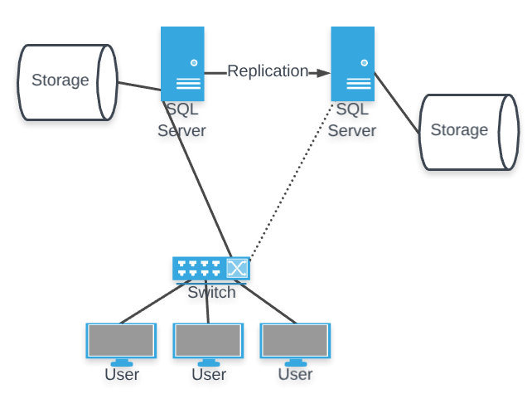
Replication
The concept of replication is that you have two completely distinct SQL Servers running. One is “active”, the other is “standby”.

Slide 13
What’s that “replication” arrow?
There are three different models of replication, but the idea is that data flows from the “master” to the “backups”.

Slide 14
Snapshot Replication
Periodically, the whole database is streamed from the master to the standby machines.
This is good when:
You can afford to lose some period of work
Most of the data changes for most snapshots
Limited bandwidth, especially during active changes
Tiny databases

Slide 15
Transactional Replication
As a transaction is committed, it is sent to the other servers which play back the same transaction. This keeps all of the servers in sync. An initial snapshot happens when replication starts.
Use when you can’t afford to lose many changes, you have good connectivity between servers and you have many changes.
Note that changes can still fall behind – network or disk contention, locking, etc.

Slide 16
Merge Replication
Bidirectional replication – all servers can accept changes. Rules are used to decide “who wins.” These rules can be as simple as “latest timestamp wins.”
Use Merge Replication when you need to have multiple servers receiving changes – it is your only option.
An example of this might be a remote site with poor connectivity – you can’t afford the latency to have all of the changes happen across the network in realtime.

Slide 17
Language Problems…
SQL is a good language, but it is a domain specific language – it doesn’t have any object orientation, any complex structures or the ability to create new data types.
Consider a few possibilities: 1) You need to store and work with a specific data type (GPS coordinates, maybe)
2) You need to run a simple algorithm on every row, but the amount of data makes this unreasonable.
3) You’ve built complex business rules in code and want to enforce them in the database for SQL users.

Slide 18
CLR Integration
SQL Server has the ability to run .NET code from SQL.
You can write stored procedures, triggers, functions, types and aggregations (like MIN and MAX) in .NET languages. Because this is compiled, it may be faster than your SQL (but may not).
If you write your application in .NET, you can even share objects between the database and the backend.
Finally, you can move .NET code off of the SQL Server to another machine if the economics change. It is harder to do that with SQL.

Slide 19
What is it good for?
CLR code can NOT replace SQL – it has no access to tables/rows except through it’s normal pathway (ADO.NET)
It’s not “make it fast” or “avoid it – it’s slow” – it can be either.
It CAN be a security risk if not handled correctly
It’s not an “all or nothing”

Slide 20
What is it good for?
It can stream through datasets in a way that table valued functions cannot
You can control threading and exception handling
It an share/cache memory across sessions (both good and bad)

Slide 21
An example of a CLR stored procedure
Build the C# code and create a .DLL
Copy the .DLL to the SQL Server
CREATE ASSEMBLY MyAssembly FROM ‘c:\mydll.dll’ WITH PERMISSION_SET = SAFE;
(safe, external_access – access outside DB, unsafe – call native code)
CREATE PROCEDURE myProc AS EXTERNAL NAME Namespace.Class.StaticMethod

Slide 22
Reporting
In a typical organization, business/management employees will need to see data that is stored in the database. They will typically not know SQL and will need help to get the data that they need.
Traditionally, the way that this is handled is through reports.
SQL Server has a reasonably good reporting system built in – SSRS (SQL Server Reporting Services).

Slide 23
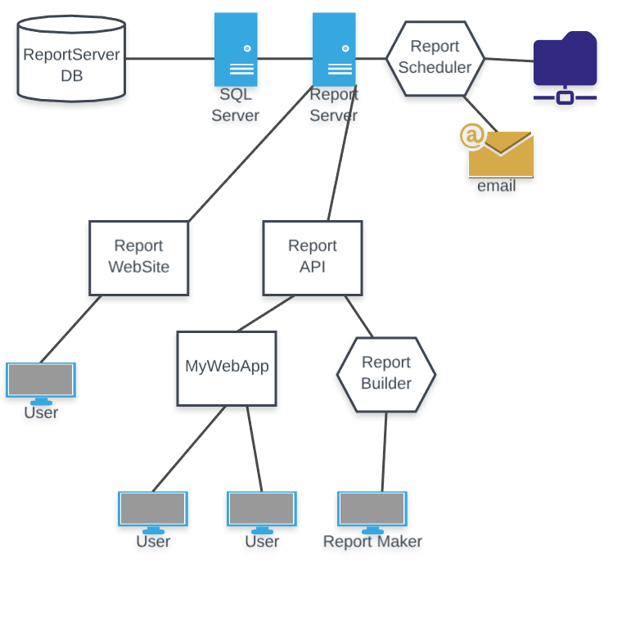
SSRS Structure

Slide 24
Key Concepts in SSRS
DataSource – a connection (server, database, credential combination)
DataSet – tied to a DataSource – a Table, View, Stored Procedure, Query
.RDL – Report Definition Language – the format reports are stored in (XML)
SubReport – a report that is rendered and the rendered data is added to your report; a form of composition for reports
Data Visualizations – Graphs and Charts

Slide 25
Reports Advice
Create every report as a view or (if you have to) stored procedure.
Treat your reports as code – check them into source control, then deploy them to the server.
Take advantage of the ability to automatically email/generate reports
SSRS isn’t the prettiest, but it is FREE…

